Slide 1

Task FMRI pipeline – what are we even doing?

Slide 2
Task_step0
Construct NIfTI files
Organize according to BIDs

Slide 3
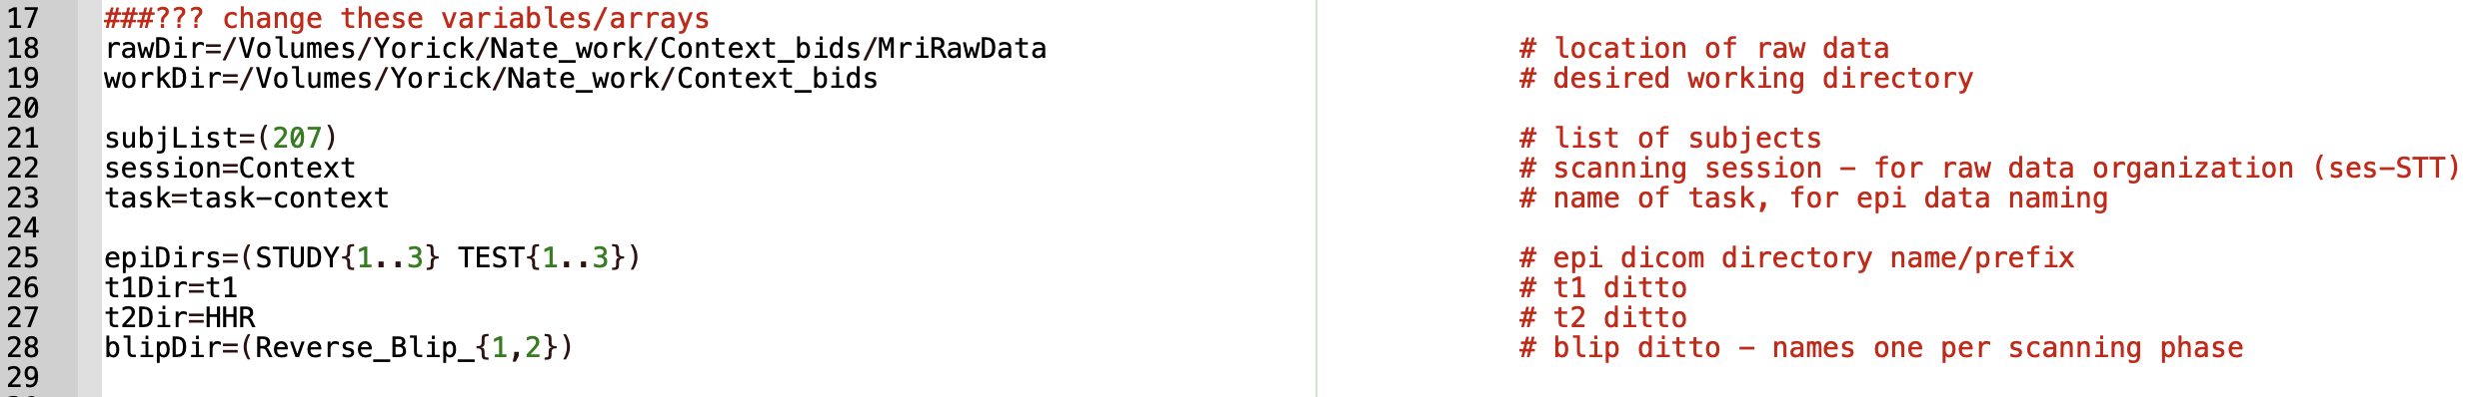

Slide 4
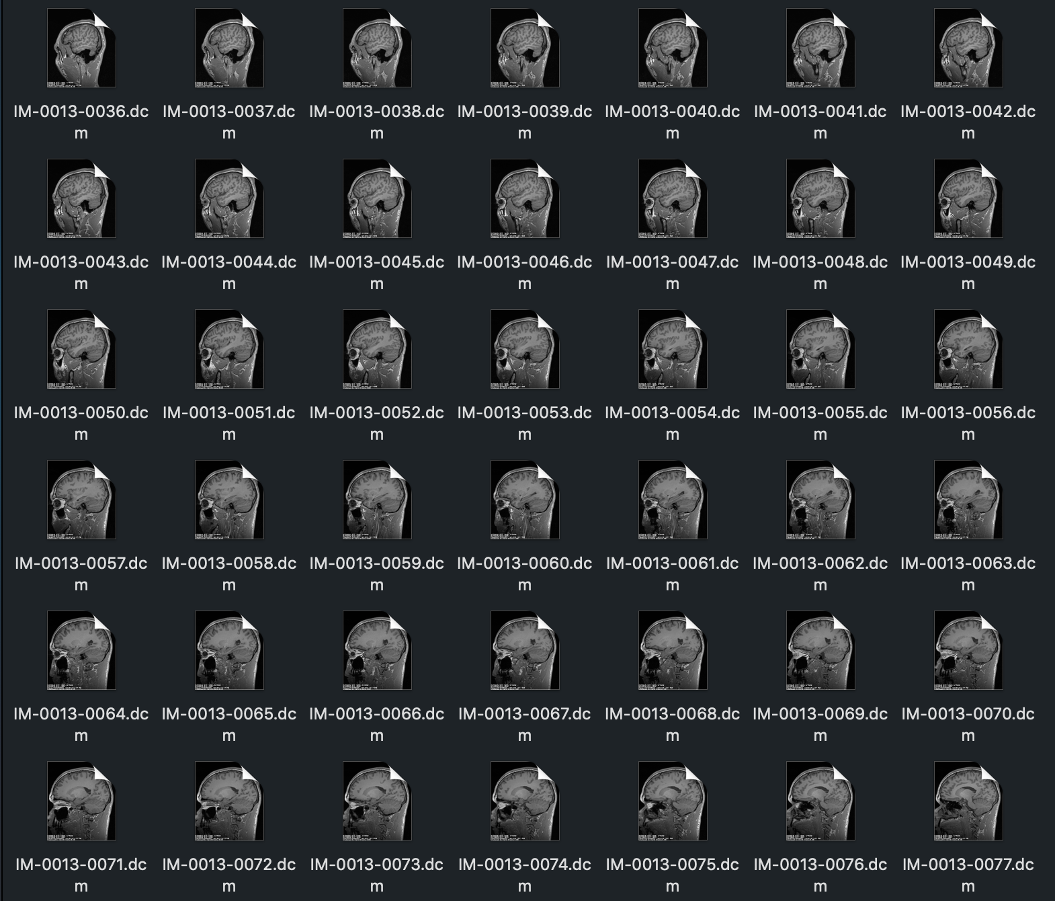
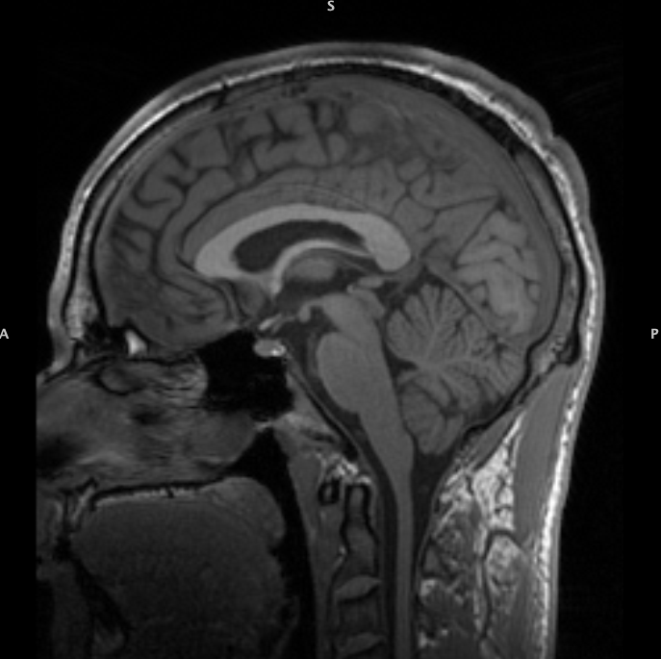
1) DICOMs to NIfTI
for both T1-weighted (structural) and T2*-weighted (functional)

Slide 5
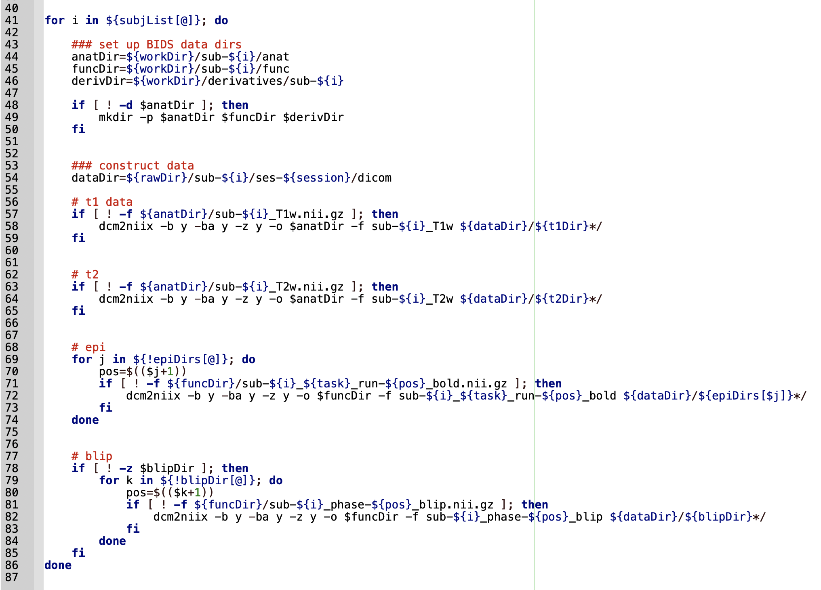

Slide 6
Task_step1
General pre-processing of functional data

Slide 7
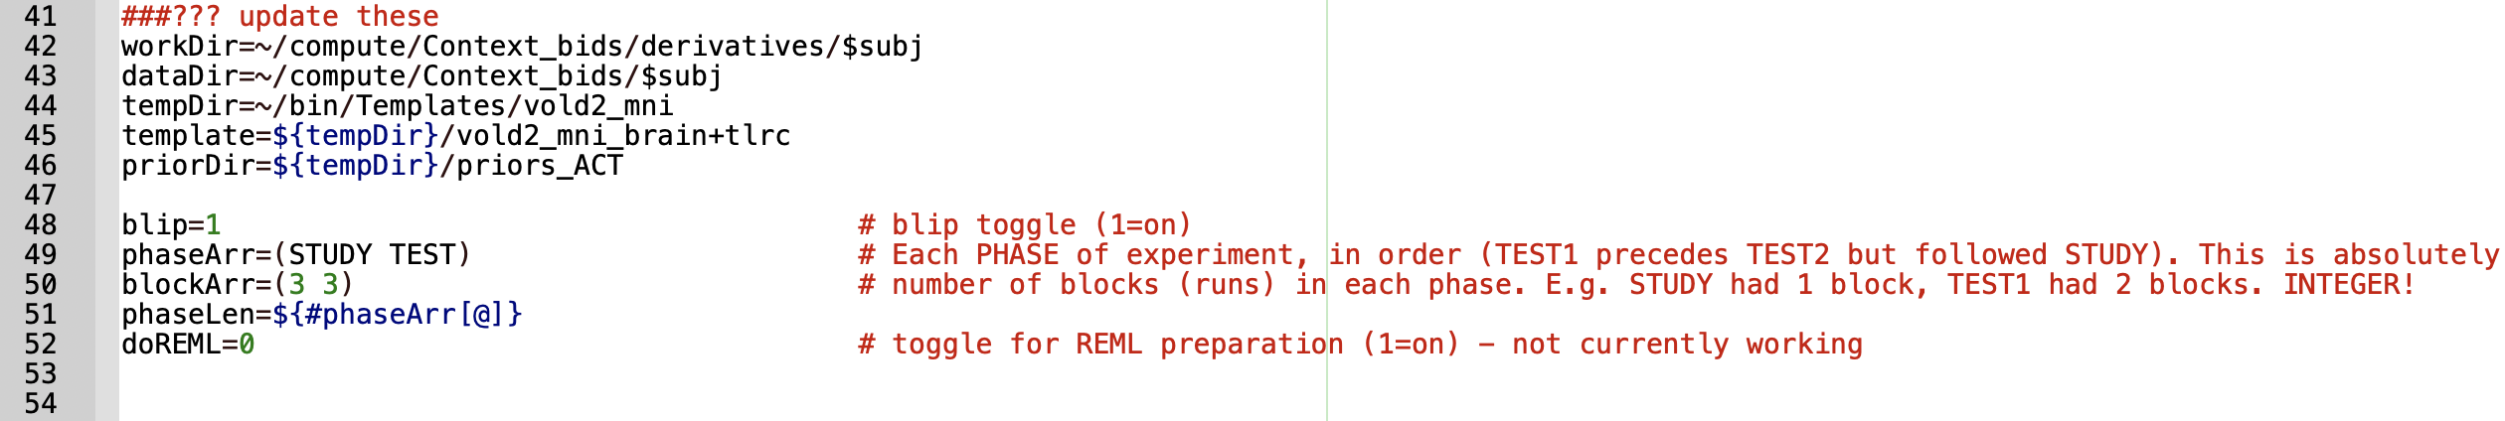
Notes:
Written for bids format
All of the variables to change is where you wan
Work dir – working on all the data
Data dir = houses the derivative for each subject
tempDir =
Template
Brain prior = hippocampal masks
not truly a mask but need to point it to the prior directory
Make sure to send the templates to the super computer too
Blilp = 1 for on
if no blip data change to 0
phaseArr = can set if your study has multiple phases
like context has a study and a test
BlockArr = number of studies and number of tests
phaseLen – just counting
doREML = leave as 0 because not finished yet
the newer way to do deconvolutions but it’s more complicated and nate is busy

Slide 8
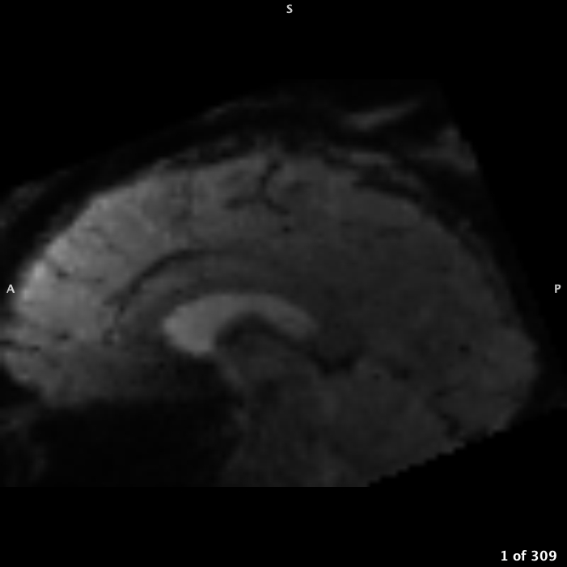
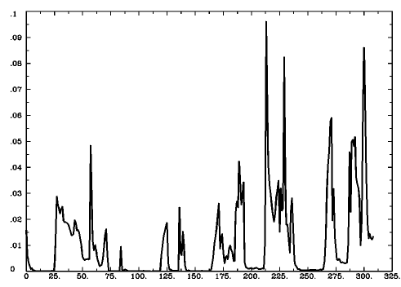
1) DICOMs to NIfTI
2) Determine T2*w proportion of outliers, create censor
and figure out the run that contains the best volume
Notes:
Play the video on the left
Across all of the volumes across each run, for each volume determine which proportion of voxels have signal outlier
Signal outliers are caused by motion, noise, etc. therefore the idea of this is to come and
T2* - intermediate TE and long TR
functional scan essentially

Slide 9
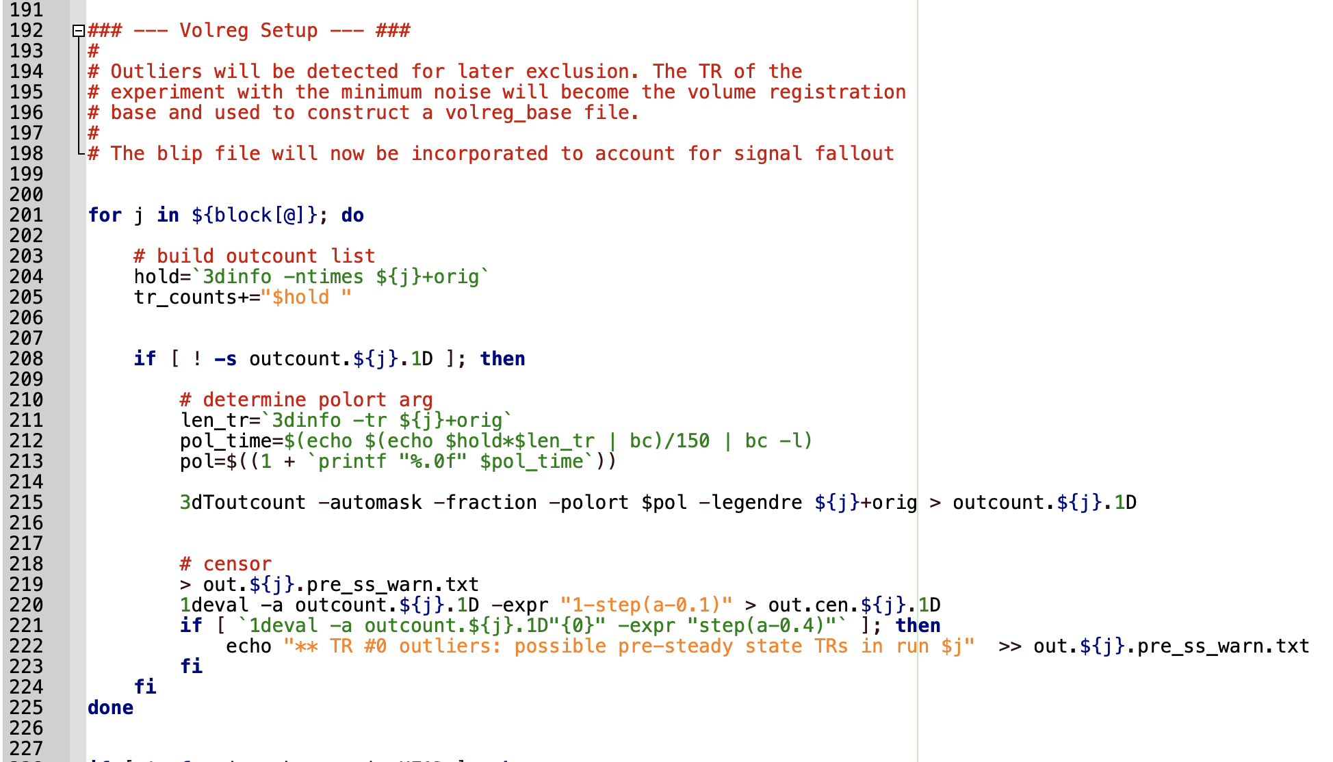
Notes:
This code does what is described before
This is done for each run and for each block – for context 6 times
Ask if people want to go through the code and if not I will keep going if yes then Nate can take over
3dToutCount - Calculates number of 'outliers' a 3D+time dataset, at each time point, and writes the results to stdout.

Slide 10
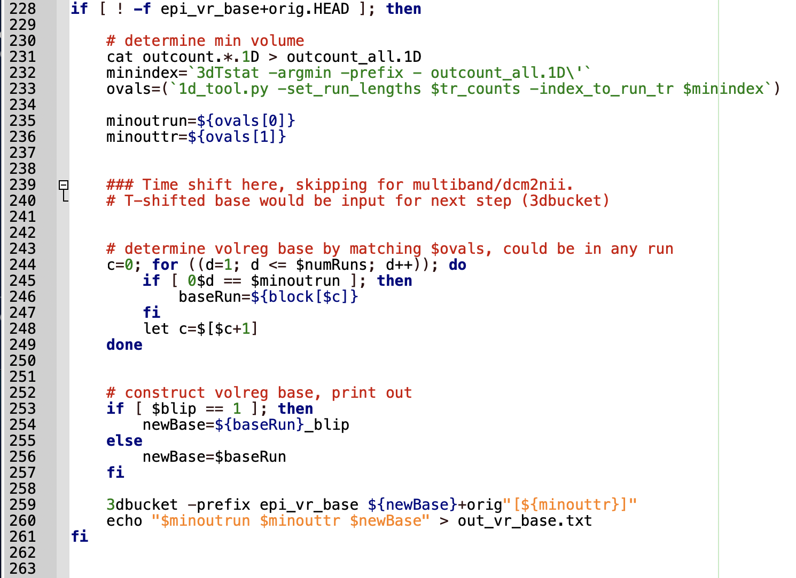
Notes:
The point is for the entire experiment
Stich together all of the outlier info for the entire experiment and find the volume with the minimal number of outliers – the best volume
Outliers caused by motion, noise, etc.

Slide 11
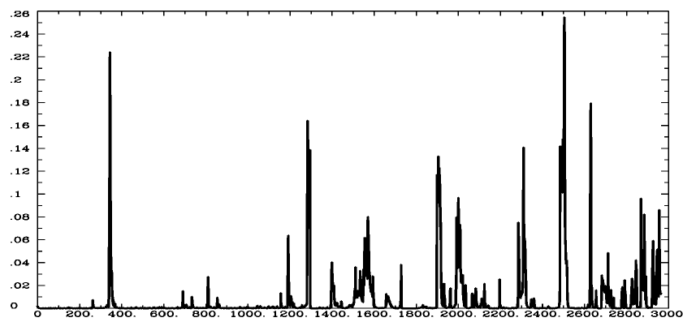
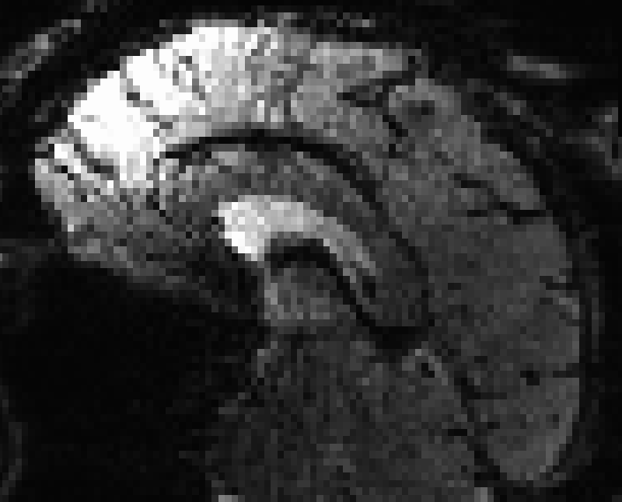
1) DICOMs to NIfTI
2) Determine T2*w proportion of outliers, create censor
3) Create a registration base from best participant volume in whole experiment
Notes:
The circle is the best volume
Have one 3D volume to use as the base volume
Instead of taking the middle one, we have a single volume registration base for the entire experiment
Then the T1 is rotated to the base
TR = repetition time = time interval between successive excitation pulses, usually in seconds
TE = echo time = time interval between an excitation pulse and data acquisition

Slide 12
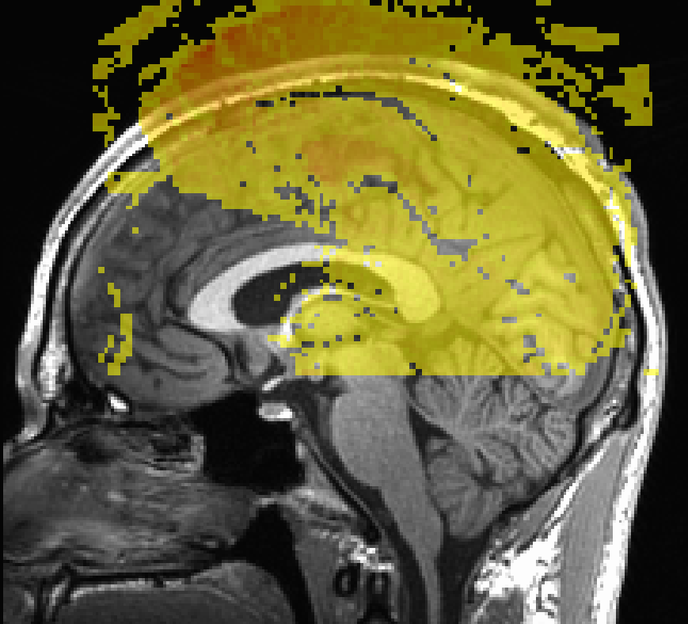
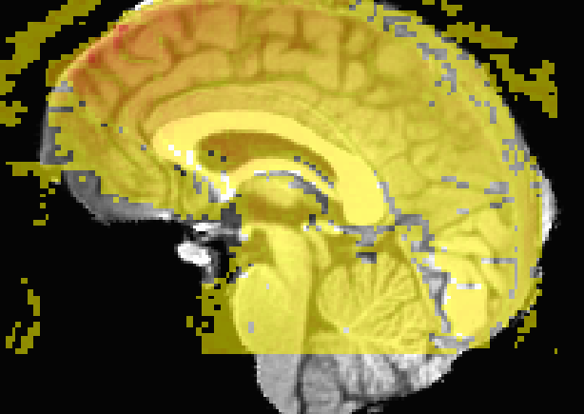
1) DICOMs to NIfTI
2) Determine T2*w proportion of outliers, create censor
3) Create a registration base from best volume
4) Align T1w to volreg base
Notes:
T1 gets rotated to the volume base
Produces calculations that are saved
Volreg – motion correction

Slide 13
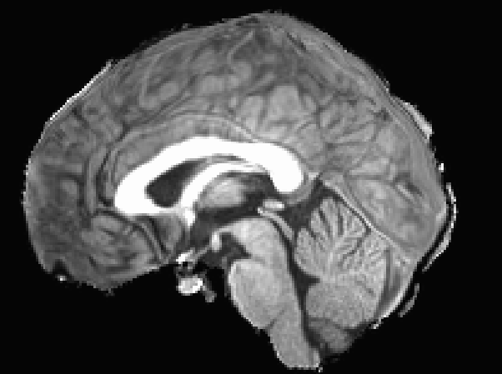
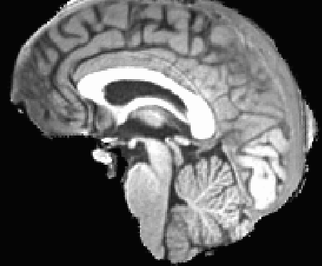
1) DICOMs to NIfTI
2) Determine T2*w proportion of outliers, create censor
3) Create a registration base from best volume
4) Align T1w to volreg base
5) Warp aligned T1w to template
to get warp calculations
Notes:
Take the rotated structural file and warp it into template space
This produces a set of calculations

Slide 14
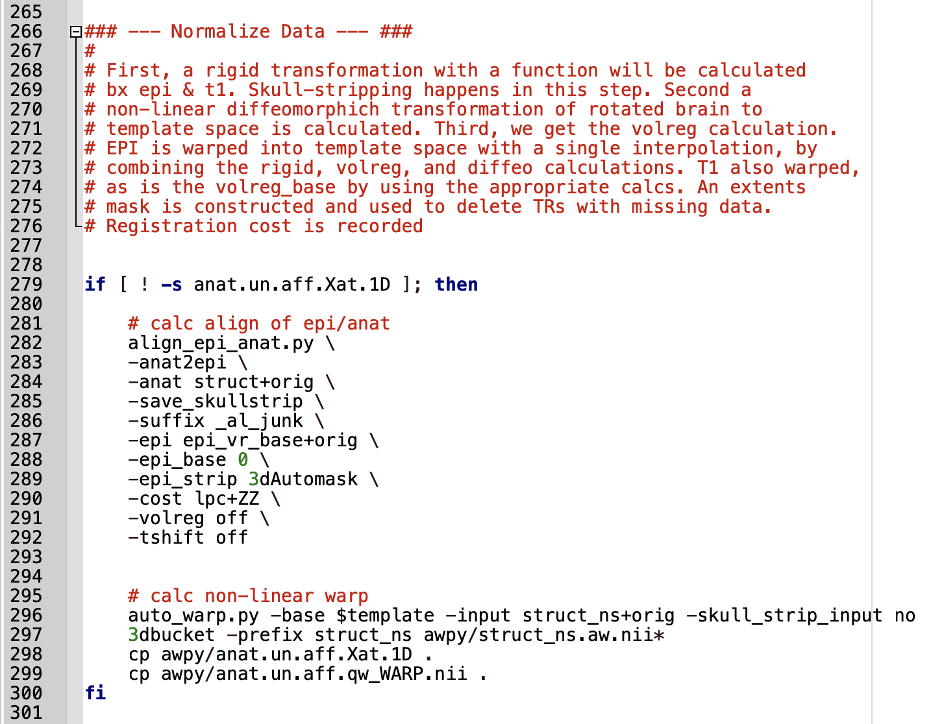
Notes:
Code that warps the t1 to template space

Slide 15
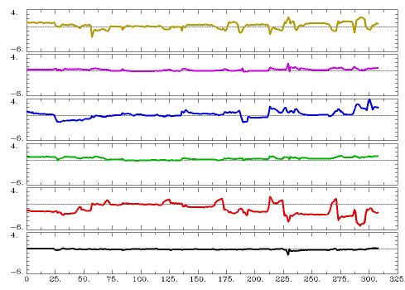
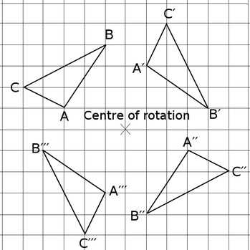
6) Calculate warp of each volume to volreg base
Notes:
Volume registration base
Each volume in the entire experiment will be rotated into that space
Not actually rotating it but getting the calculations
The right is the motion
Trying to correct for slow motion movements that people have in the scanner
Roll, pitch, yaw, etc.

Slide 16
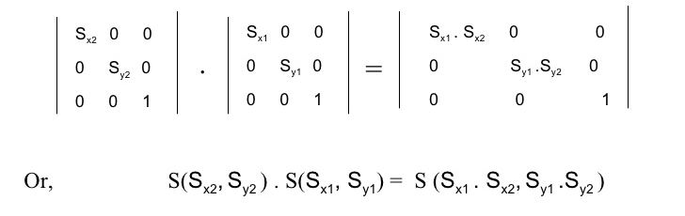
6) Calculate warp of each volume to volreg base
7) Concatenate warp calculations
a) Rigid body alignment of T1w & base
b) Non-linear alignment of T1w and Template
c) Volume registration to base
Notes:
Three sets of warp vectors
Structural to volreg
Rotated structural to template space
Each volume TR to the base volume
Combine with matrices

Slide 17
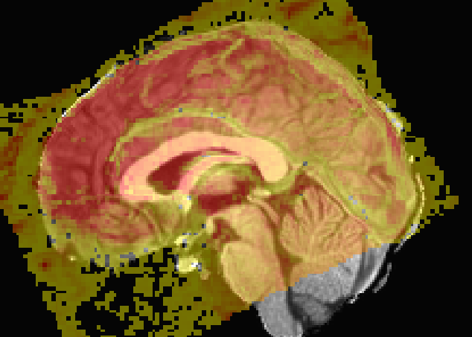
6) Calculate warp of each volume to volreg base
7) Concatenate warp calculations
8) Warp T2*w data to template space from native space
Only 1 interpolation of T2*w data is used
Notes:
These calculations are applied to the epi data in native space and then move it into template space all at one time
T2 errors where you would get false errors
Each time you interpolate the data you smooth it out a little, so the less that you actually process it then the better

Slide 18
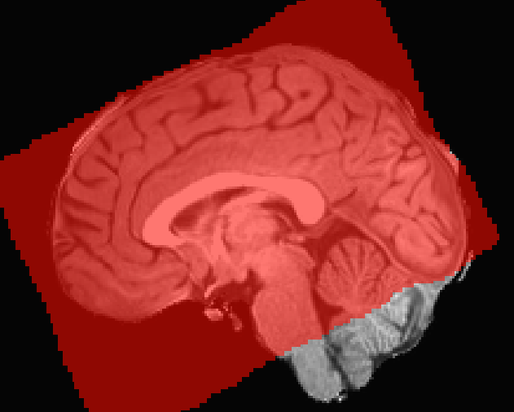
6) Calculate warp of each volume to volreg base
7) Concatenate warp calculations
8) Warp T2*w data to template space from native space
9) Create extents mask for each run – a mask of where T2*w data exists
Notes:
Create a mask in template space of where there is t2 data
Use the mask for future things

Slide 19
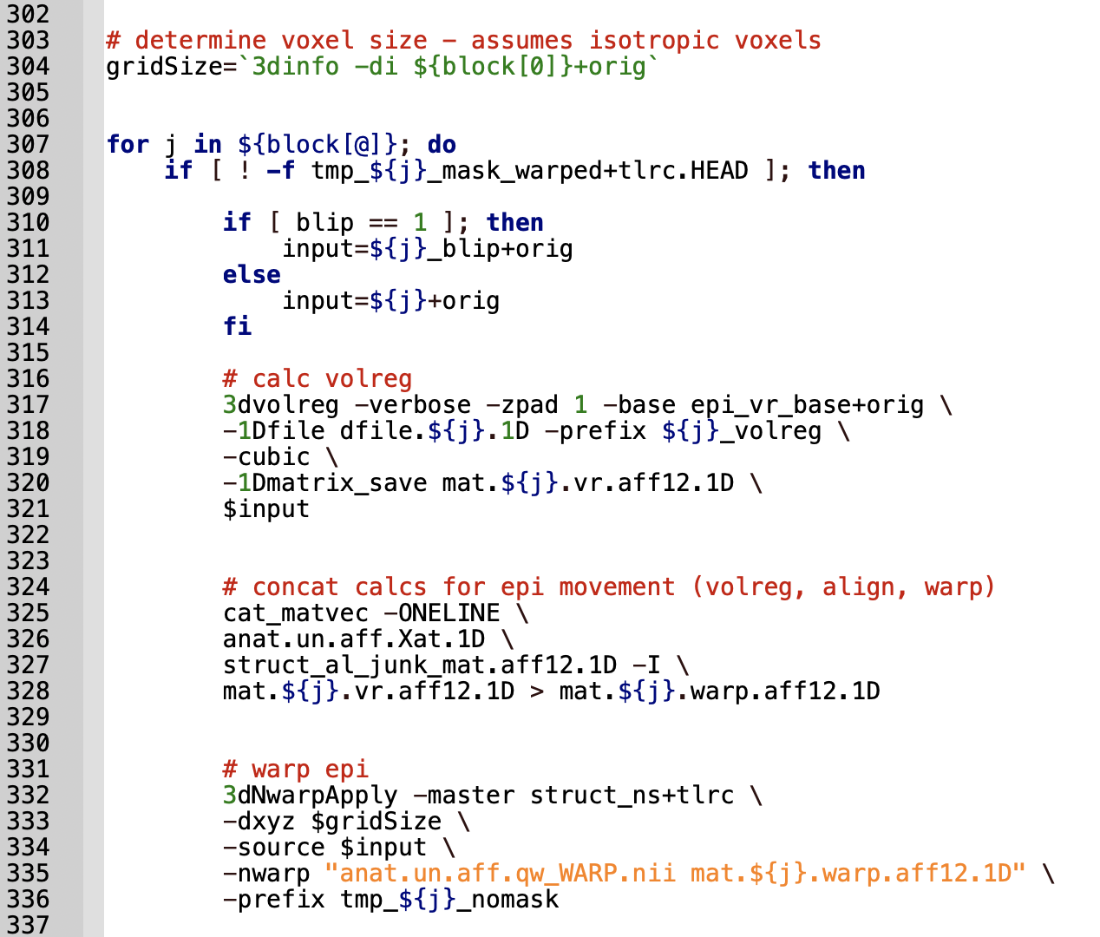
Notes:
Volume registration
Concatenating here

Slide 20
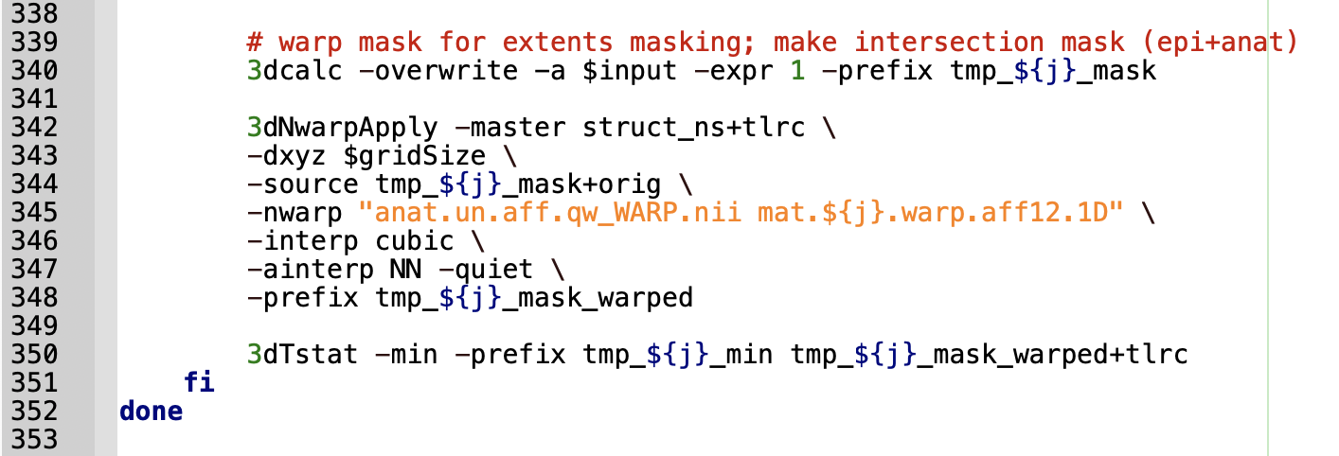
Notes:
Make the mask here

Slide 21
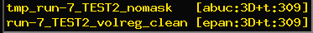
6) Calculate warp of each volume to volreg base
7) Concatenate warp calculations
8) Warp T2*w data to template space from native space
9) Create extents mask for each run – a mask of where T2*w data exists
10) Delete volumes with missing data
X
=
Notes:
Take the raw data with 309 TRs and multiply it by the mask to remove any volumes that had missing data
Doesn’t really affect the data

Slide 22
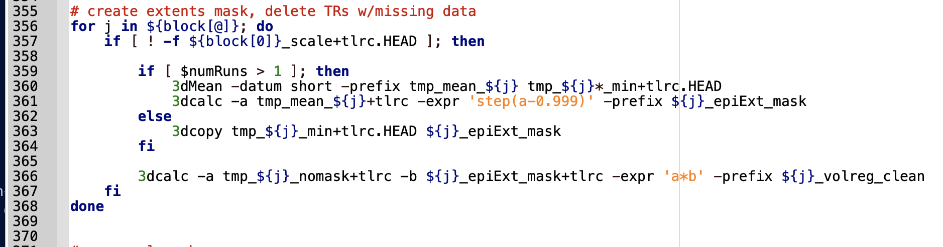
Notes:
Code that does the slide before

Slide 23
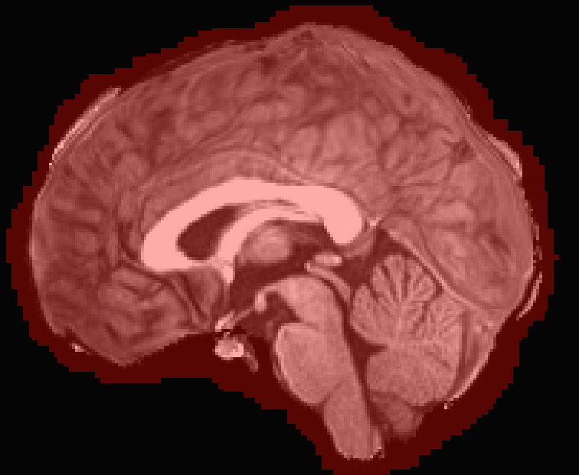
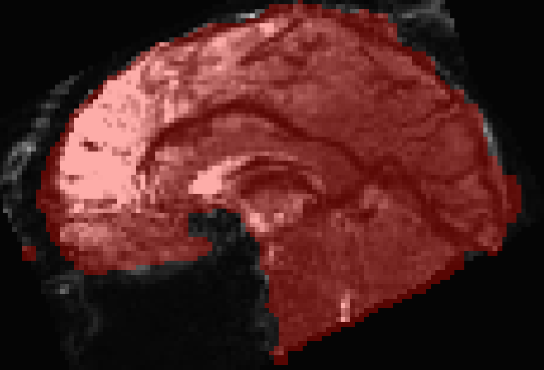
11) Create an intersection mask
A mask of coordinates that contain both T2*w and T1w data
X
=
Dilated structural mask
Participant union mask
Notes:
Intersection mask - where there is both functional and structural data, take a dialated structural mask and multiply it by a union mask
Union mask – mask across all runs in the study where there is actually fMRI signal
All of this is in template space
Can see across all of the runs
The red is where there is signal

Slide 24
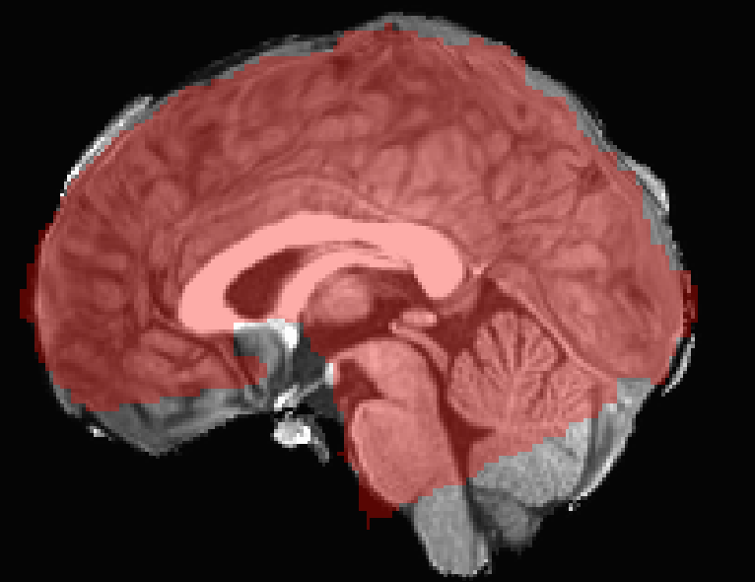
Notice the fallout – blip should help with this
Notes:
Intersection mask
Layered on the T1
There is tons of fallout, but the blip will help with it
This one doesn’t have the blip cause we don’t have that data yet

Slide 25
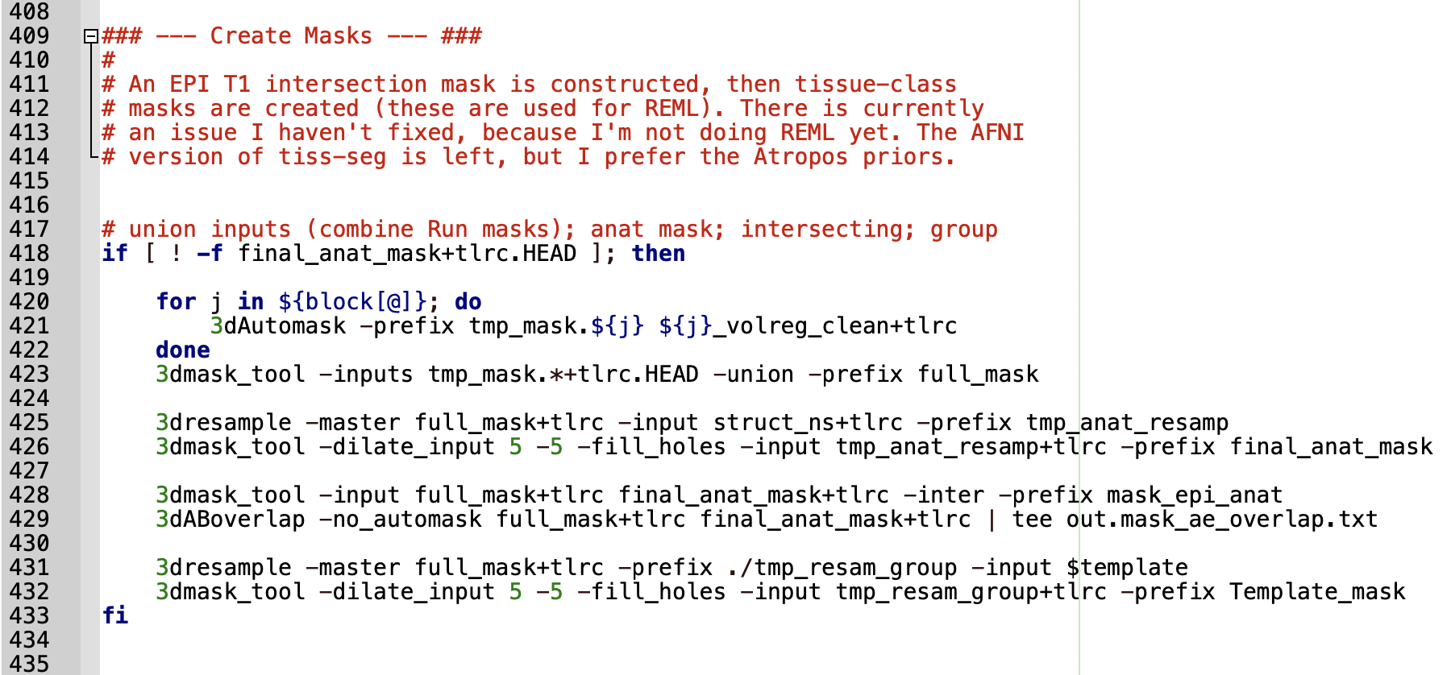
Notes:
Code that makes the masks

Slide 26
11) Create an intersection mask
12) Scale data by mean signal
also remove data not included in intersection mask
Notes:
Scale the data by the mean signal
makes everyone’s signal in the same range
signal changes over time because of drift
and people have different properties (like old people give off less signal but they are still working just as hard)
Multiplying the signal by the intersection mask to exclude voxels that don’t really have fMRI

Slide 27
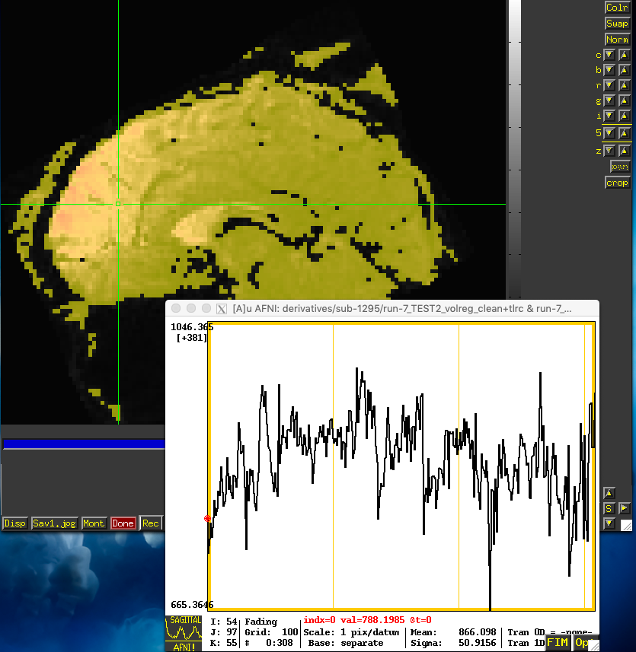
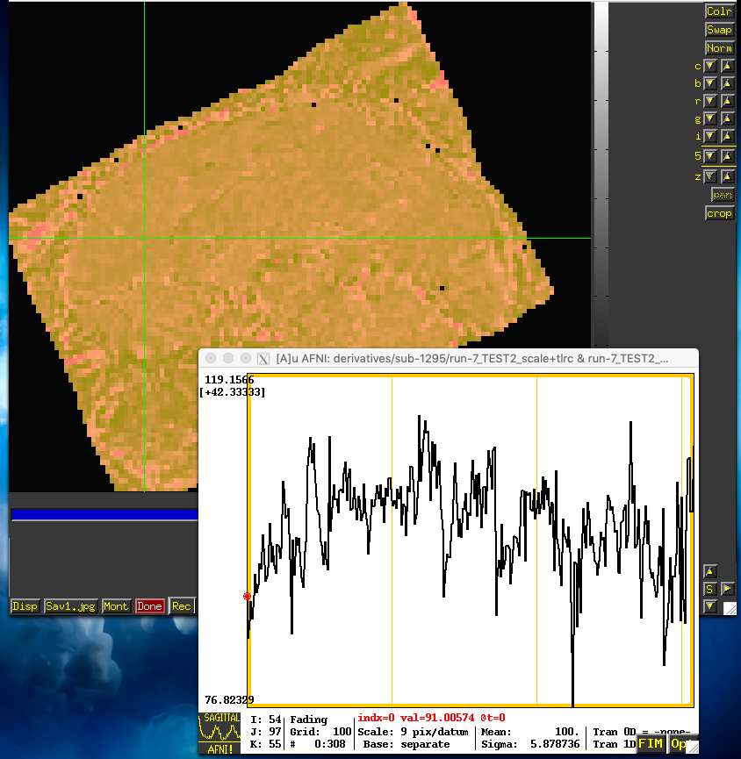
Notes:
Time doesn’t change but the signal is all in the same range
The signal doesn’t change from one to the next

Slide 28
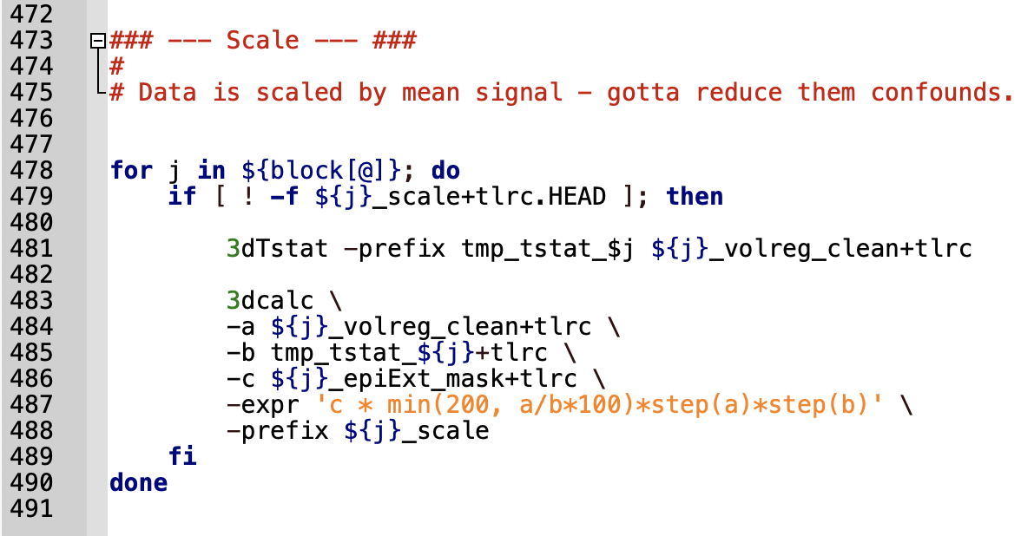
Notes:
Code that does the scaling

Slide 29
Task_step2
Deconvolve data

Slide 30
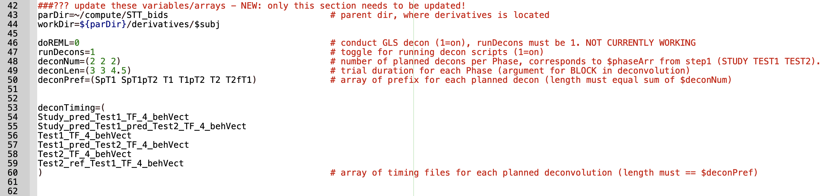
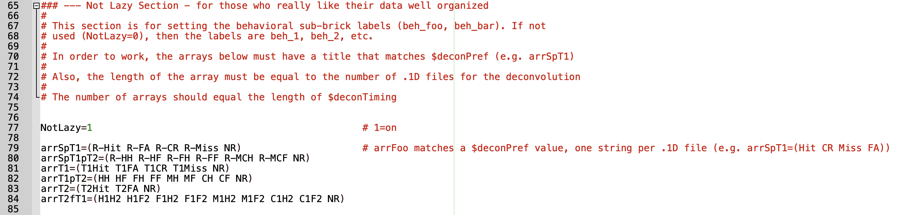

Slide 31
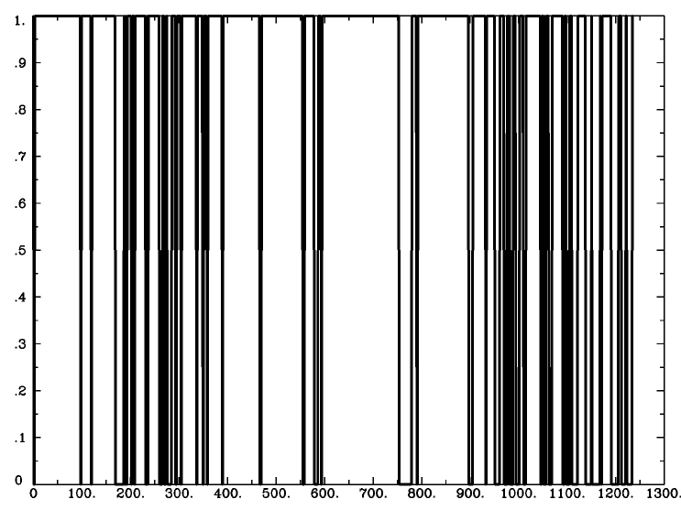
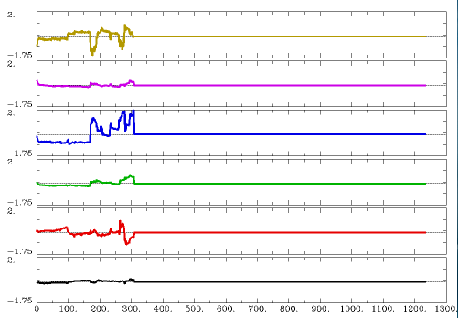
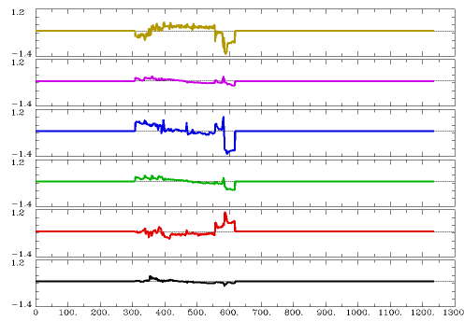
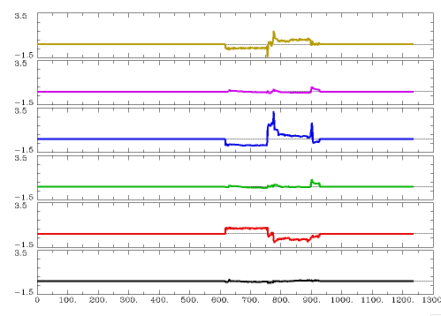
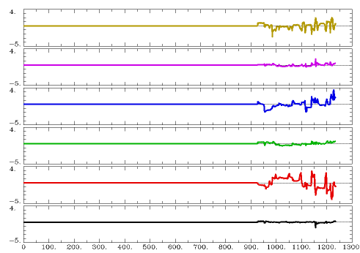
13) Create motion files for each run (4 here)
and all needed censors

Slide 32
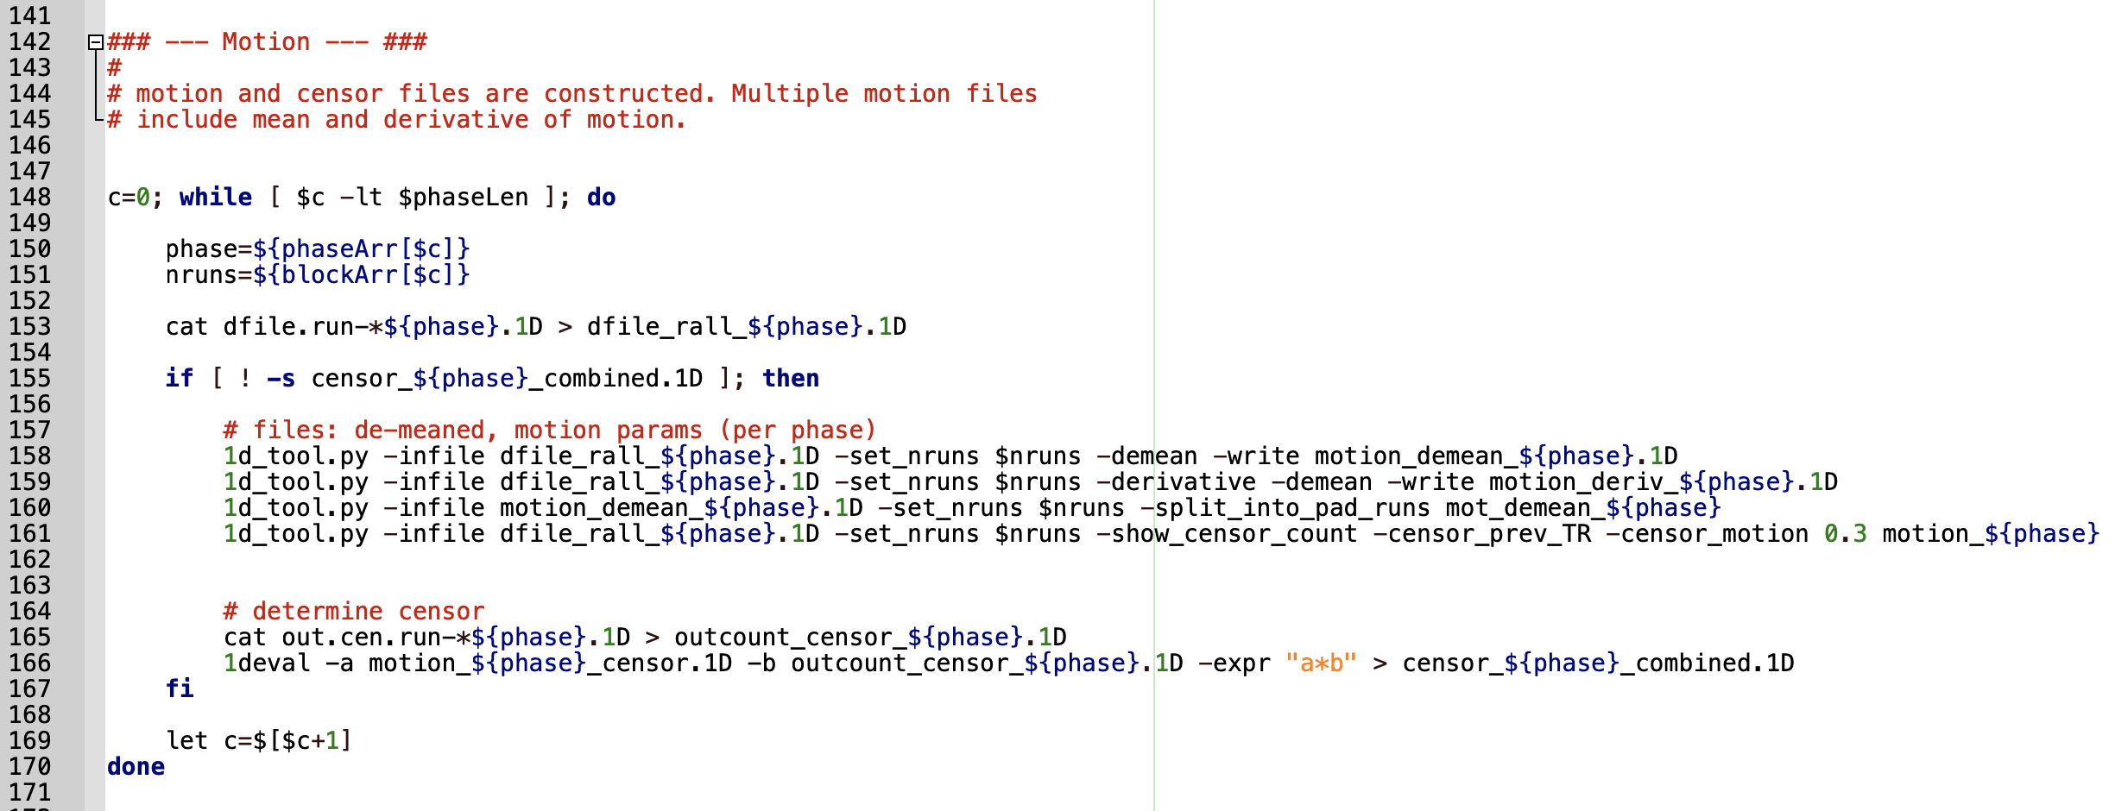

Slide 33
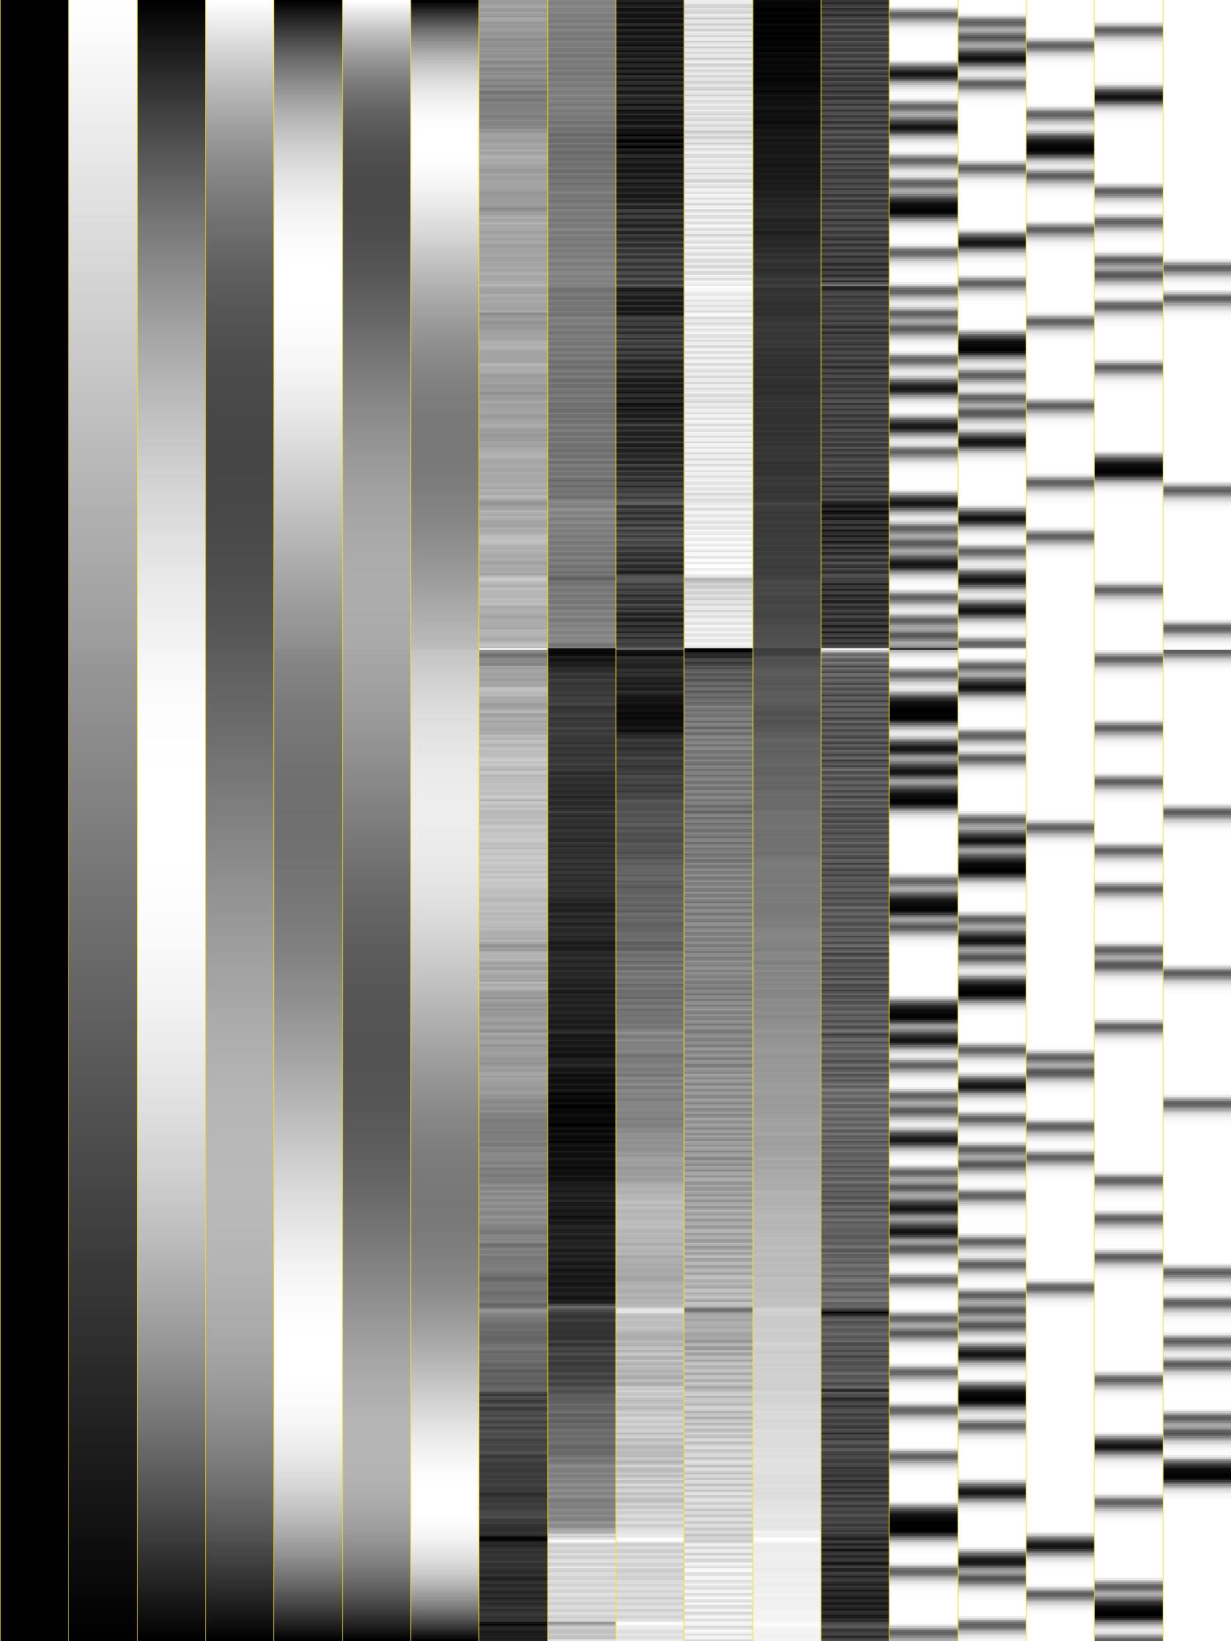
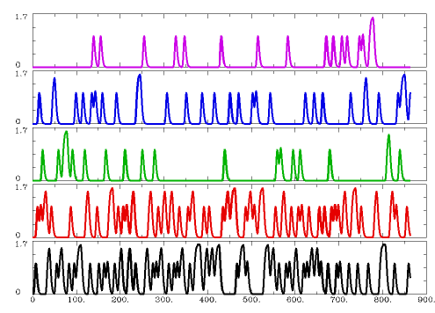
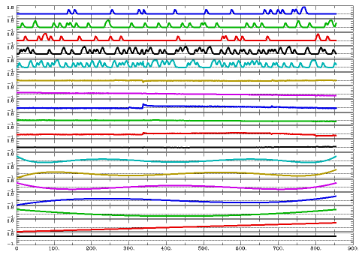
13) Create motion files for each run (4 here)
14) Deconvolve data
Polynomials
Motion
Behavior

Slide 34
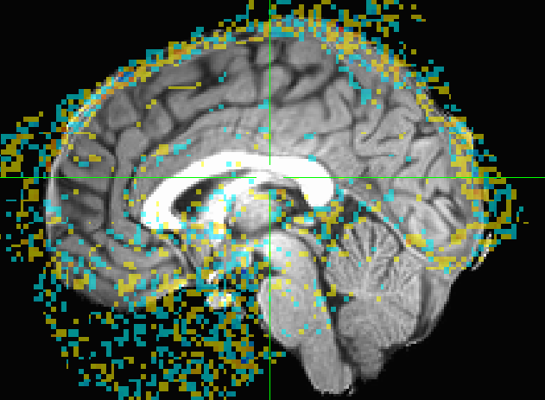
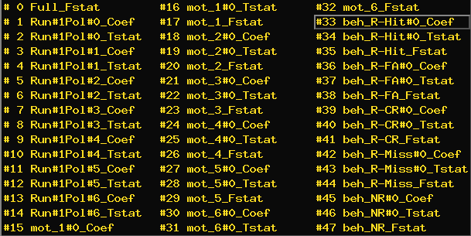

Slide 35
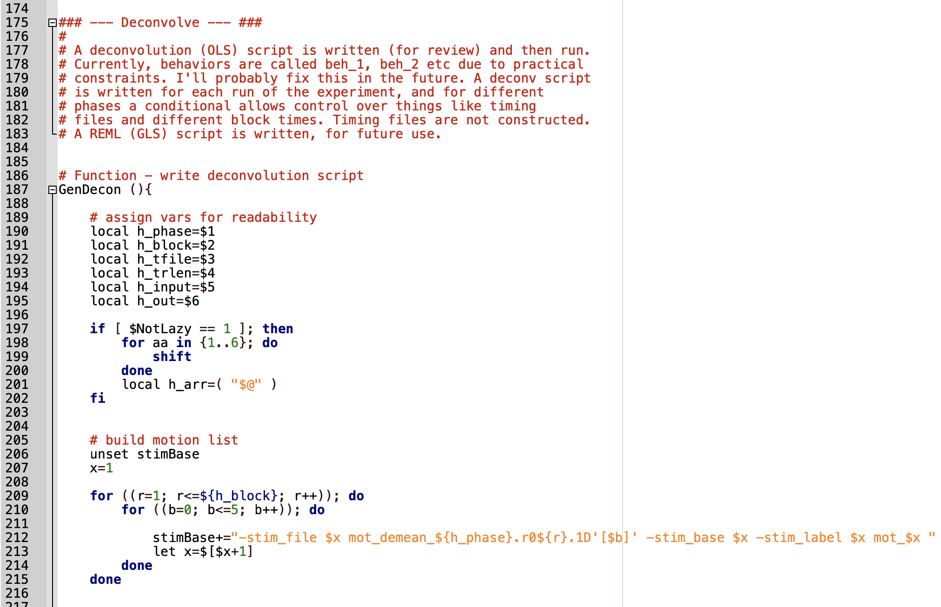

Slide 36
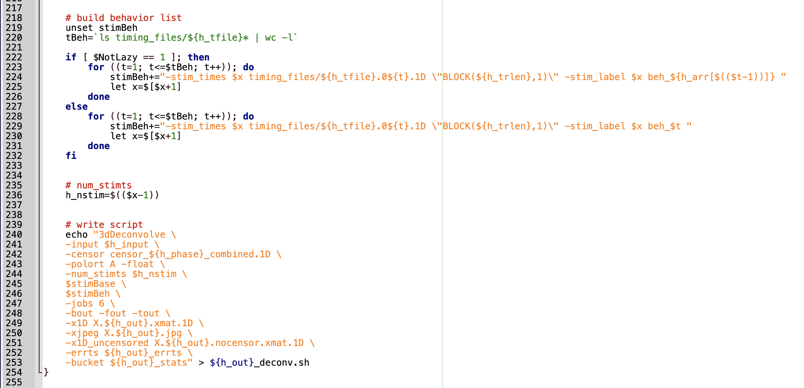

Slide 37
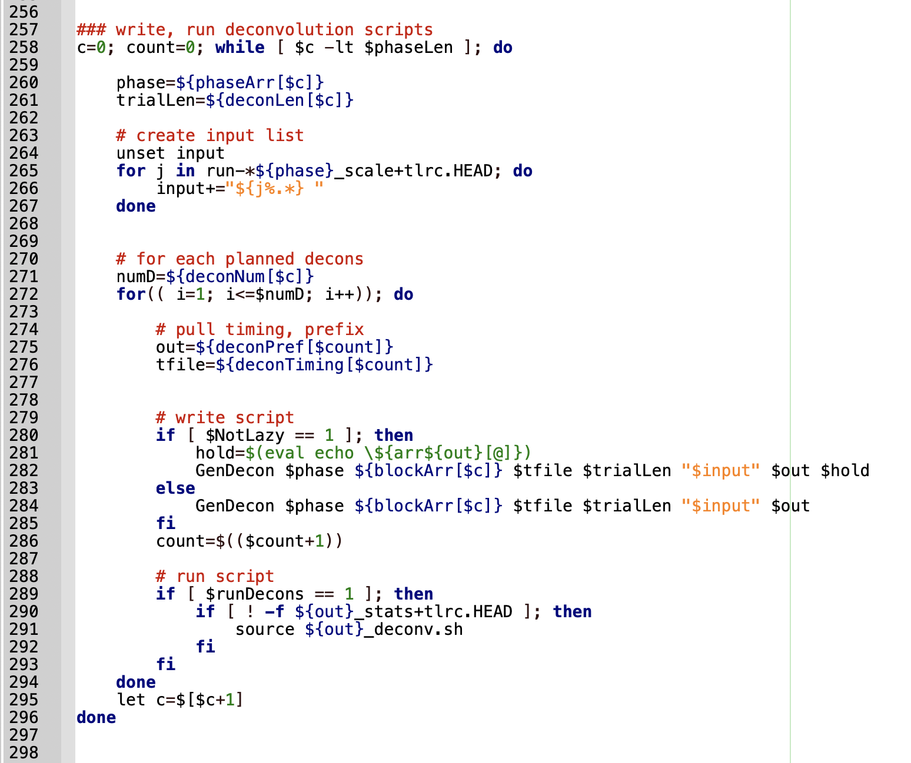

Slide 38
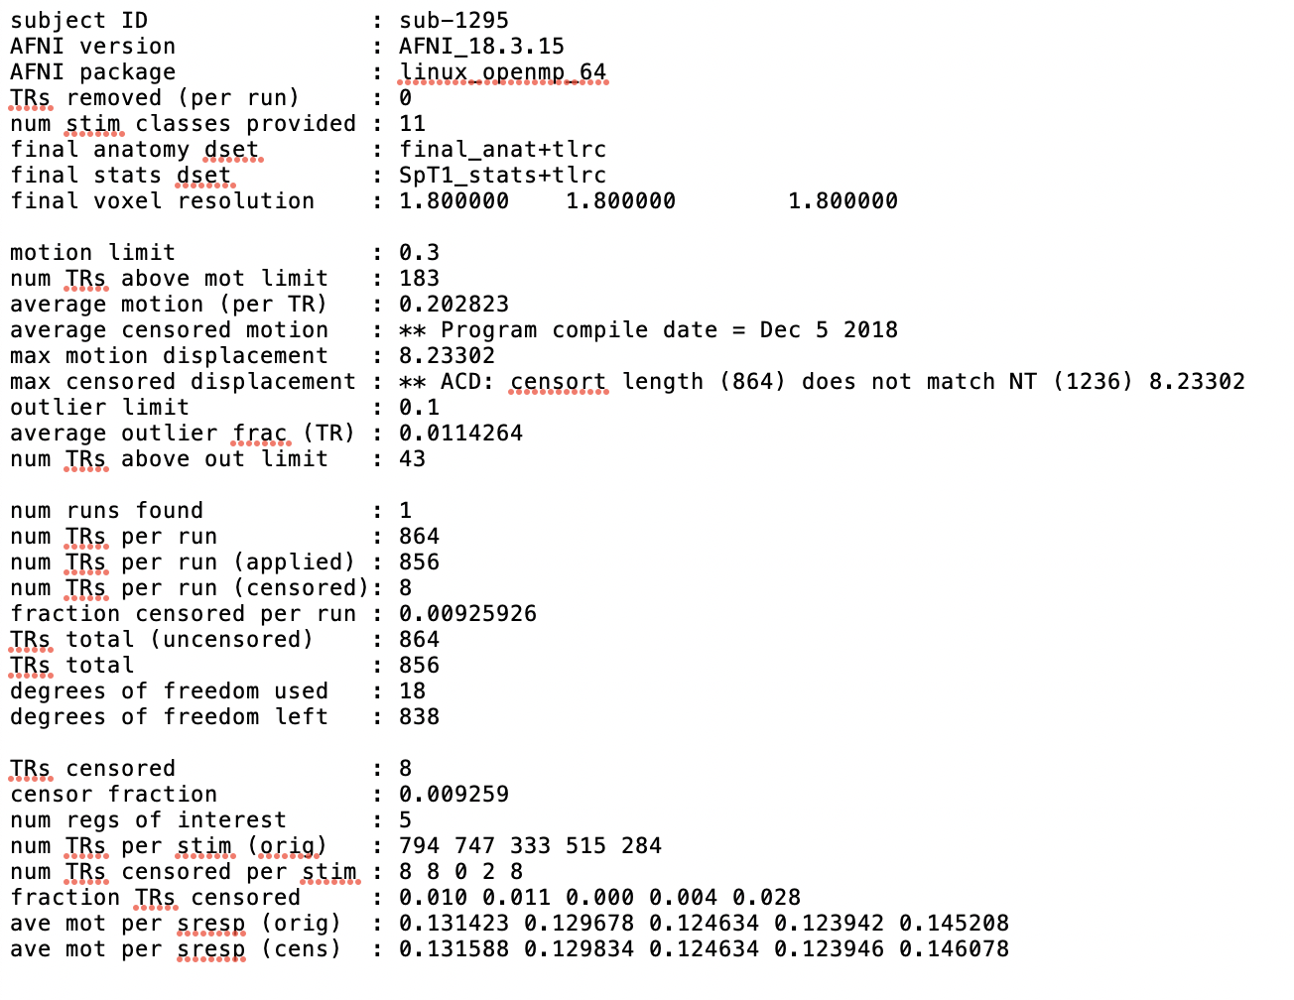
13) Create motion files for each run (4 here)
14) Deconvolve data
15) Write info out for each deconvolution

Slide 39
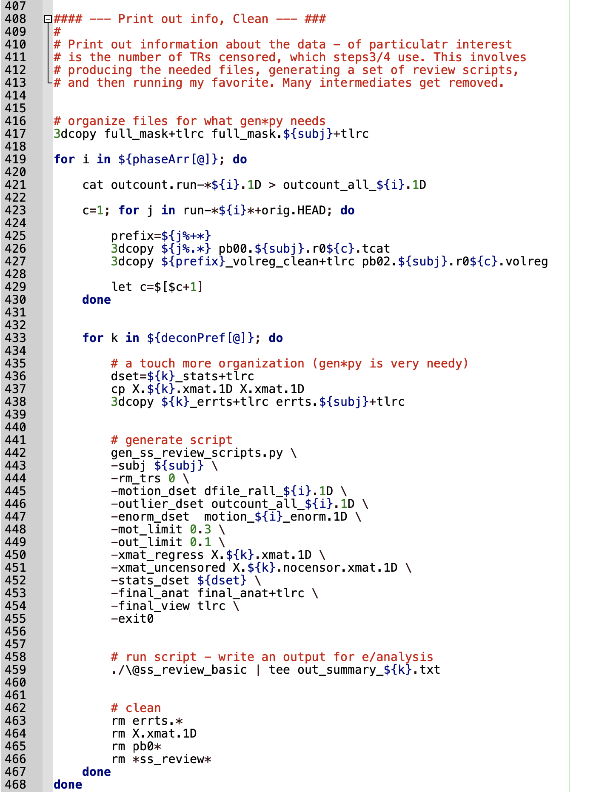

Slide 40
Task_step3
Determine which participants had too many volumes removed

Slide 41


Slide 42




16) Determine outliers of movement (>1.5*IQR)
or who had >10% volumes removed

Slide 43


Slide 44
Task_step4
Conduct exploratory whole-brain analyses

Slide 45




Slide 46


17) Create group intersection mask
both average and thresholded. Union is officially endorsed

Slide 47

17) Create group intersection mask
18) Create gray matter intersection mask
X
=

Slide 48


Slide 49


Slide 50

17) Create group intersection mask
18) Create gray matter intersection mask
19) Run ETAC
for AvsB analyses
Cox, R. W. (2018). Equitable thresholding and clustering. bioRxiv, 295931.

Slide 51

Cox, R. W. (2018). Equitable thresholding and clustering. bioRxiv, 295931.

Slide 52






Contrast, no blur
Contrast, for each blur
T1_ETAC_Decon_A-B+tlrc
T1_ETAC_Decon_A-B.B4.0.nii

Slide 53




Contrast, all output collapsing across blur and p-value
Contrast, brick per blur & p-value
*ETACmaskAll.global.*nii.gz
*ETACmask.global.*nii.gz

Slide 54
17) Create group intersection mask
18) Create gray matter intersection mask
19) Run ETAC
20) Extract individual cluster masks
called etac_indiv
Contrast, brick per blur & p-value
A set of clusters for each blur, p-value combination
Collapse across p-values for each blur
*ETACmaskAll.global.*nii.gz

Slide 55


Slide 56


Slide 57


Slide 58


Slide 59
Alternatively, conduct MVM for non AvsB analyses

Slide 60

21) Blur stats and residuals, simulate noise
Shah, S. I., Smith, M., Swaminathan, D., Parker, I., Ullah, G., & Demuro, A. (2018). CellSpecks: A Software for Automated Detection and Analysis of Calcium Channels in Live Cells. Biophysical journal, 115(11), 2141-2151.

Slide 61



Slide 62


Parameter estimates
Threshold criteria
Simulations

Slide 63


Slide 64



Slide 65



21) Blur stats and residuals, simulate noise
22) Write, Run ANOVA script

Slide 66


Slide 67


Slide 68


